Slide 1
Enhancing Hydraulic Jaw Crusher Capacity by Modifying Plate and Rod Sizes for Larger Ingots
By Aditi Verma
(Student trainee)

Slide 2
Abstract
This study focuses on optimising the design of plates and rods for a hydraulic jaw crusher capable of handling larger ingots. The project involved calculating the forces exerted by the hydraulic cylinder and subsequently analysing the resulting forces and stresses on the rod and plate components. By comprehensively evaluating these factors, the aim was to design plates and rods that can withstand the applied forces and stresses effectively. This research contributes to enhancing the crusher's performance and durability, ensuring reliable operation in industrial applications where robust equipment is essential.

Slide 3
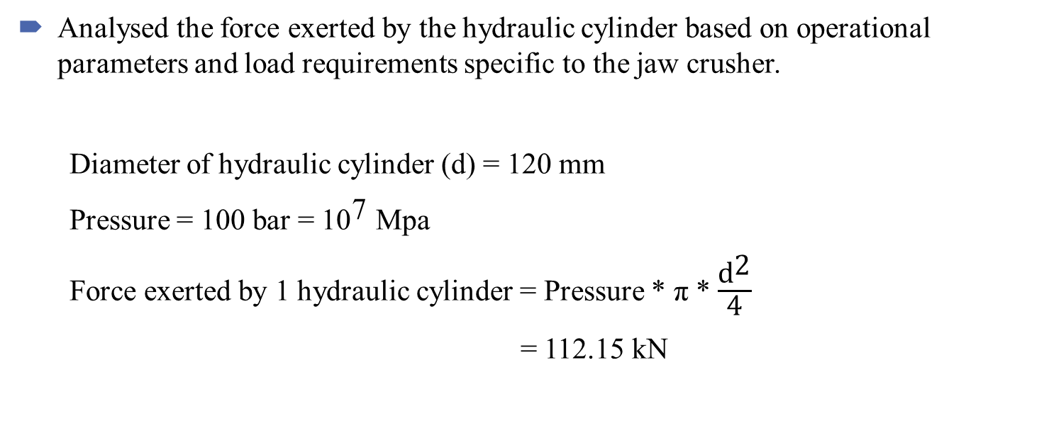
Steps Taken
Analysed the force exerted by the hydraulic cylinder based on operational parameters and load requirements specific to the jaw crusher.
Diameter of hydraulic cylinder (d) = 120 mm
Pressure = 100 bar = ${\text{10}}^{\text{7}}$ Mpa
Force exerted by 1 hydraulic cylinder = Pressure * π * $\frac{{\text{d}}^{\text{2}}}{\text{4}}$
= 112.15 kN

Slide 4
Steps Taken
Identified key stress factors, including shear stress from the hydraulic cylinder and bending stress due to its positioning relative to the plate.
Force applied by 4 hydraulic cylinders = 452.6 kN
Height of crushing plate (h) = 500 mm
Length of crushing plate (l) = 1410 mm
Distance from the centres of the tie rod = 1240 mm

Slide 5
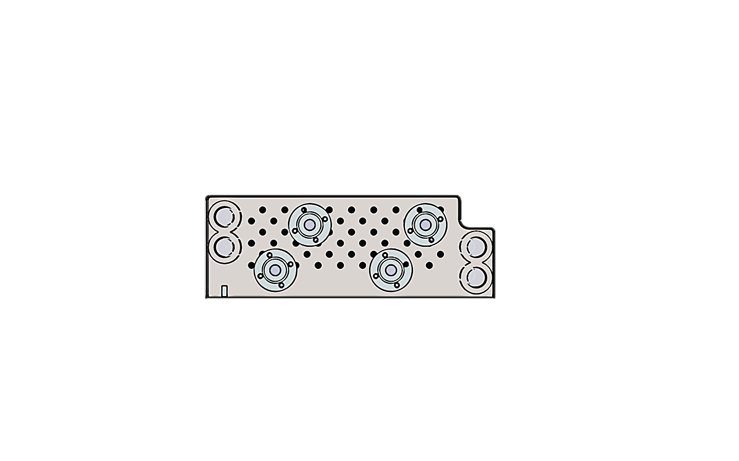

Bending stress applied by 1 hydraulic cylinder:
New positions of hydraulic cylinders due to the increase in plate’s length From the centre:
${\text{Length}}_{\text{1}}$ = 215 mm
${\text{Length}}_{\text{2}}$ = 355 mm
Average distance of the hydraulic cylinders from the centre of the crushing plate = 285 mm
Moment = 113.15 kN X 285 mm = 65 kNm
Bending stress ($σ_{b}$) = $\frac{\text{M} \text{∗} \text{y}}{\text{I}}$
y = 1/2 thickness of plate
I =$1/12∗h∗t^{3}$
$σ_{b}$= $0.78/t^{2}$ MPa
215 mm
355 mm

Slide 6
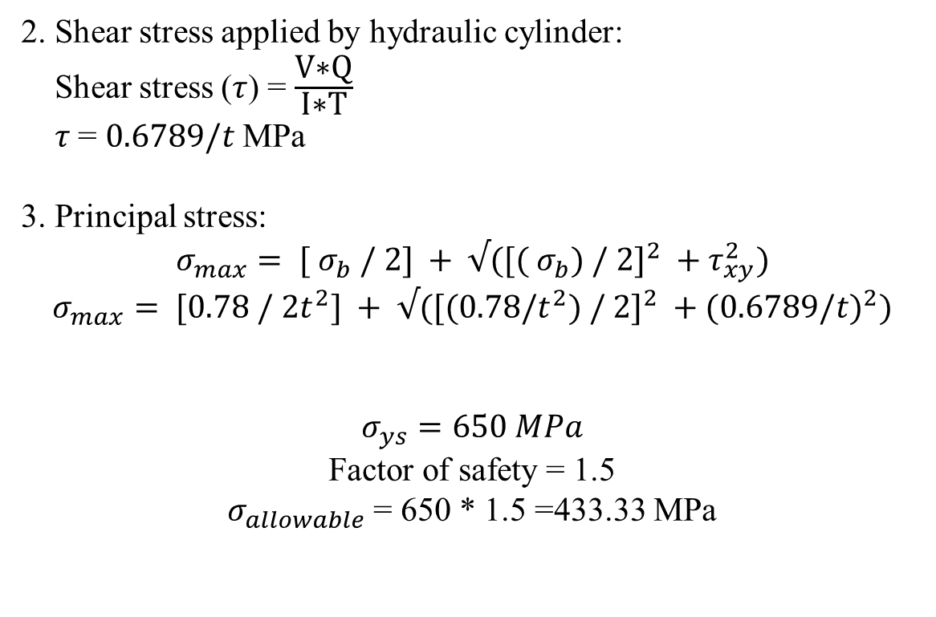
2. Shear stress applied by hydraulic cylinder:
Shear stress ($τ$) = $\frac{\text{V}\text{∗}\text{Q}}{\text{I}\text{∗}\text{T}}$
$τ$= $0.6789/t$MPa
3. Principal stress:
$$σ_{max}= [ σ_{b} / 2] + √([( σ_{b}) / 2]^{2} +τ_{xy}^{2})$$
$$σ_{max}= [0.78 / 2t^{2}] + √([(0.78/t^{2}) / 2]^{2} +(0.6789/t)^{2})$$
$$σ_{ys}=650 MPa$$
Factor of safety = 1.5
$σ_{allowable}$ = 650 * 1.5 =433.33 MPa

Slide 7
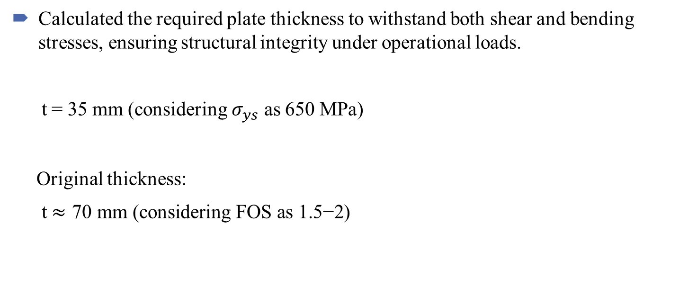
Steps Taken
Calculated the required plate thickness to withstand both shear and bending stresses, ensuring structural integrity under operational loads.
t = 35 mm (considering $σ_{ys}$ as 650 MPa)
Original thickness:
t $≈\text{70} \text{mm}\text{ (}\text{considering} \text{FOS} \text{as} \text{1.5−2}\text{)}$

Slide 8
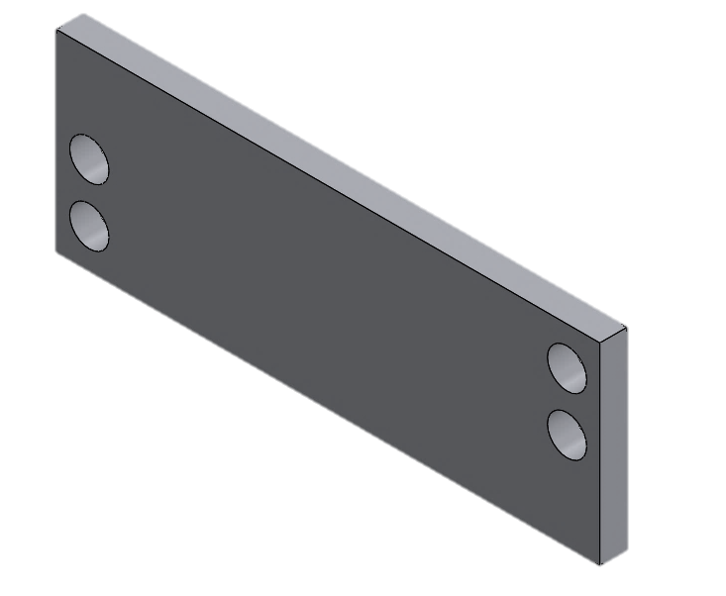
Steps Taken
Created a 3D model of the plate using SolidWorks, incorporating precise dimensions and design specifications for visualisation and refinement.
Average position of 2 hydraulic cylinders
1240 mm
Tie rod
Centre of the crushing plate
285 mm

Slide 9
Steps Taken
Utilised COMSOL Multiphysics to simulate stress distribution within the plate under various conditions, including scenarios where one hydraulic cylinder was inactive. Evaluated:
- Shear stress distribution across the plate surface.
- Plate bending considering the hydraulic cylinder’s positioning.
- Ability of the plate design to withstand stress concentrations without failure.
- Performance under realistic conditions, accounting for potential cylinder failures.
With help of this software it was concluded that 70 mm thick plate would not be suitable for a case in which one of the hydraulic cylinders stopped working hence,
Thickness of plate (t) was taken to be 120 mm

Slide 10
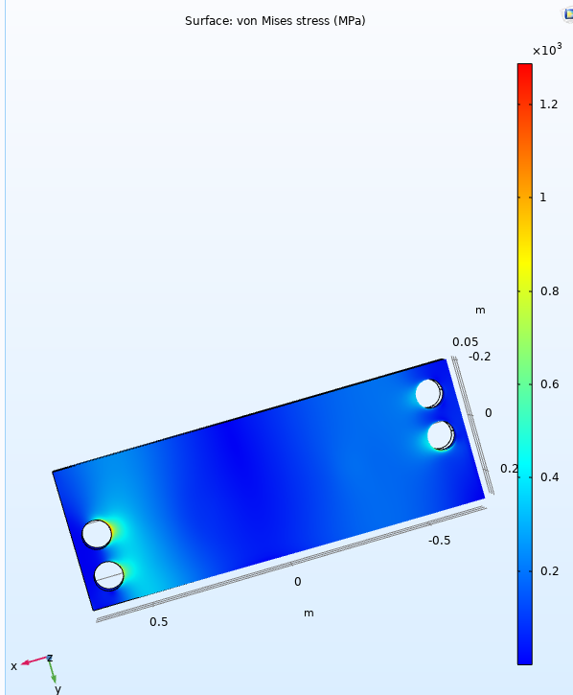
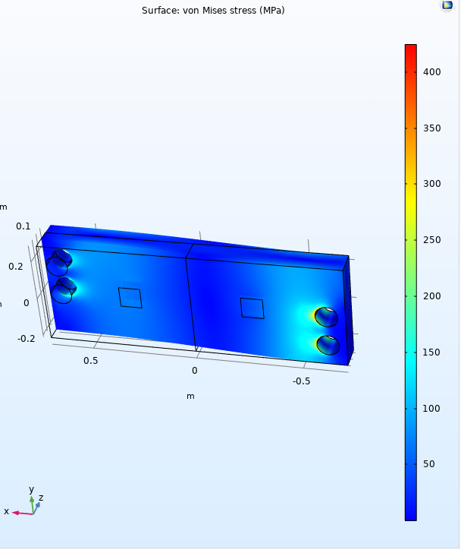
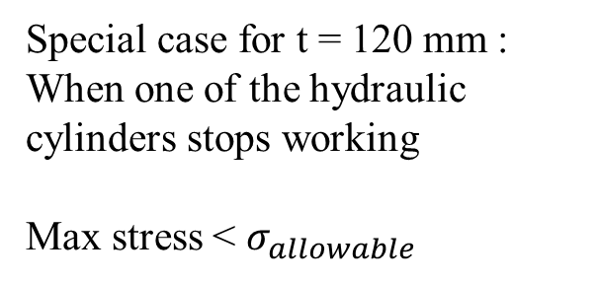
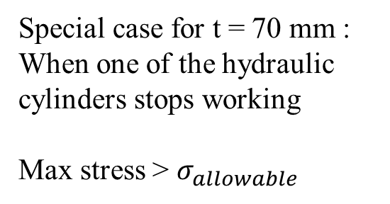
Special case for t = 70 mm : When one of the hydraulic cylinders stops working
Max stress > $σ_{allowable}$
Special case for t = 120 mm : When one of the hydraulic cylinders stops working
Max stress < $σ_{allowable}$

Slide 11
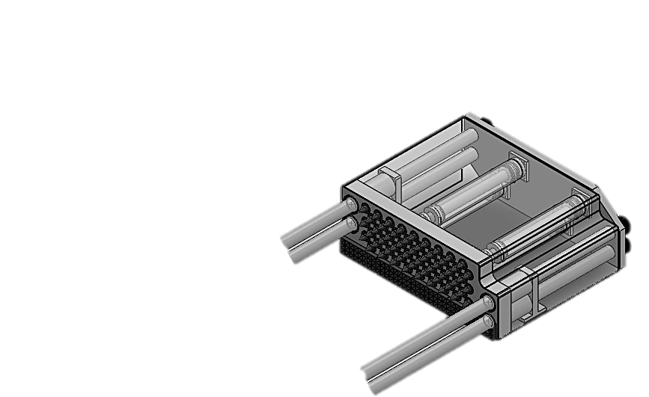
Steps Taken
After finalizing the new thickness of the crushing plate identification of key force factors on the tie rod was done by taking into account:
1. The tensile force caused due to the back plate because of the
hydraulic cylinder applying pressure in all directions:
Force from 2 hydraulic cylinders = 113.15 * 2 = 226.3 kN
Force from 4 hydraulic cylinders = 113.15 * 4 = 452.6 kN

Slide 12
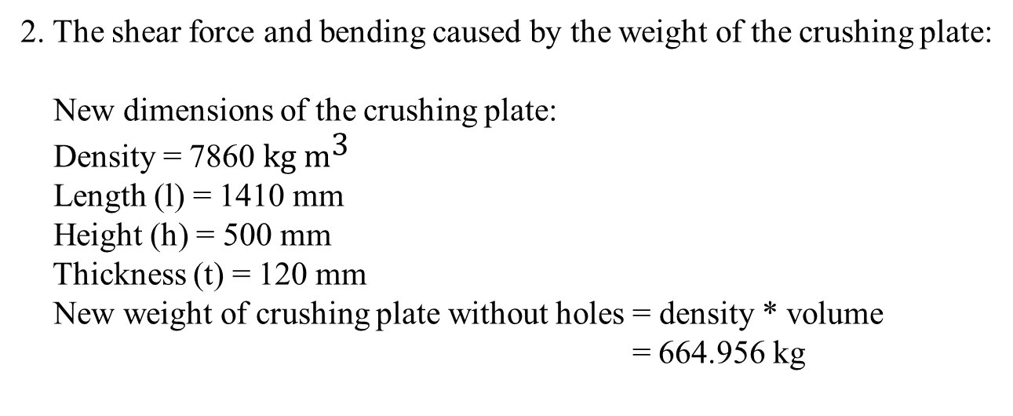
2. The shear force and bending caused by the weight of the crushing plate:
New dimensions of the crushing plate:
Density = 7860 $\text{kg} {\text{m}}^{\text{3}}$
Length (l) = 1410 mm
Height (h) = 500 mm
Thickness (t) = 120 mm
New weight of crushing plate without holes = density * volume
= 664.956 kg

Slide 13
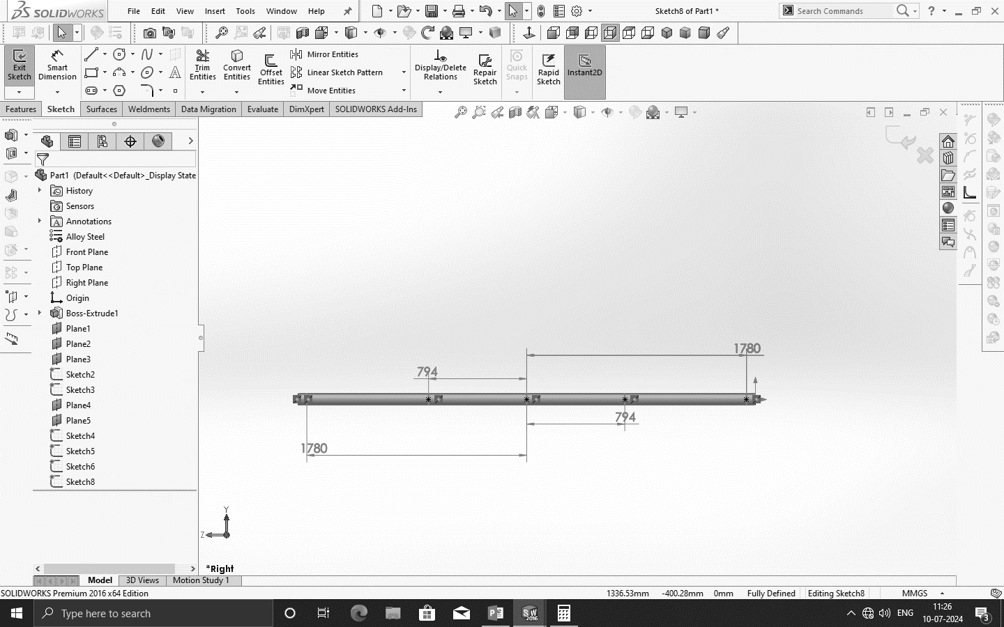
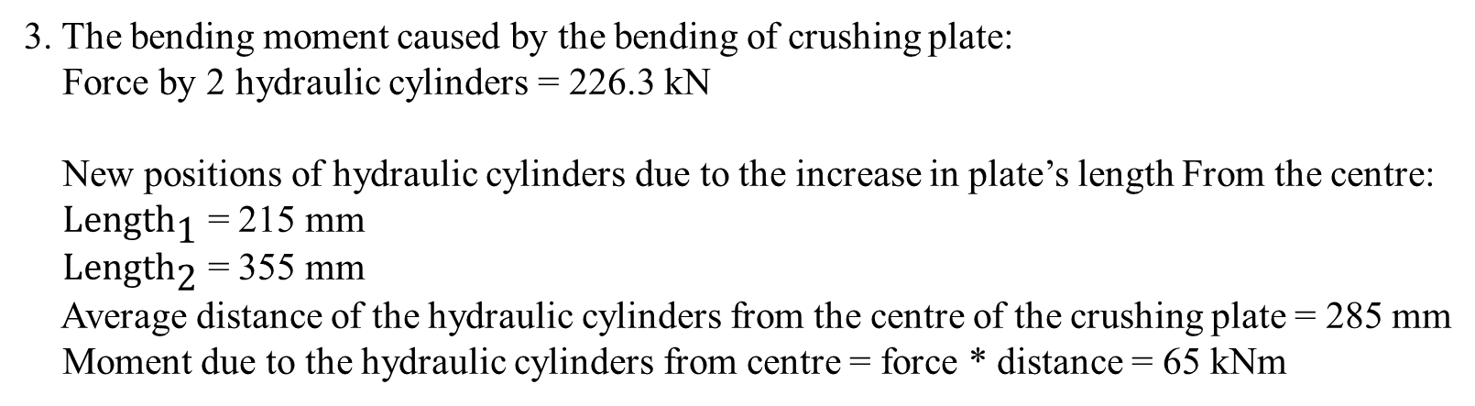
3. The bending moment caused by the bending of crushing plate:
Force by 2 hydraulic cylinders = 226.3 kN
New positions of hydraulic cylinders due to the increase in plate’s length From the centre:
${\text{Length}}_{\text{1}}$ = 215 mm
${\text{Length}}_{\text{2}}$ = 355 mm
Average distance of the hydraulic cylinders from the centre of the crushing plate = 285 mm
Moment due to the hydraulic cylinders from centre = force * distance = 65 kNm
Crushing plate
Back plate

Slide 14
Here we have taken the original diameter of 90 mm of the rod to check if it can withstand the new forces.
After the results in COMSOL multiphysics we concluded the new diameter of the rod to be unchanged and be 90 mm as the maximum stress on the tie rod was lesser than its allowable stress.

Slide 15
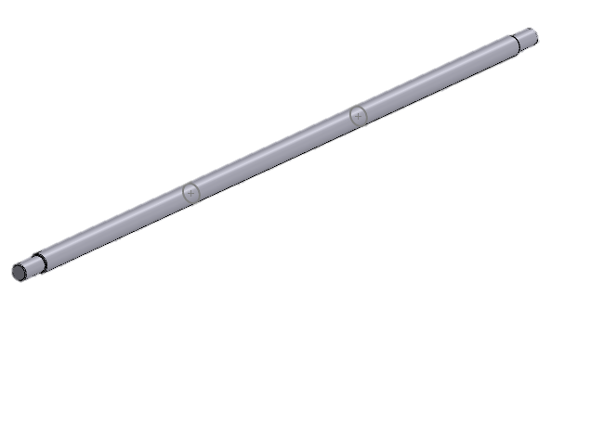
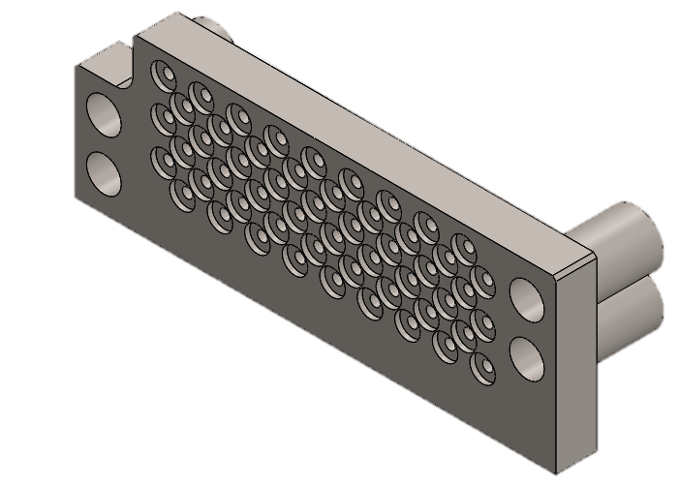
Steps Taken
Optimised the plate and rod design based on simulation outcomes to enhance strength, durability, and operational performance. Adjustments to dimensions were made as necessary and a 3-D model was made in SolidWorks.
R45
120 mm
3700 mm

Slide 16
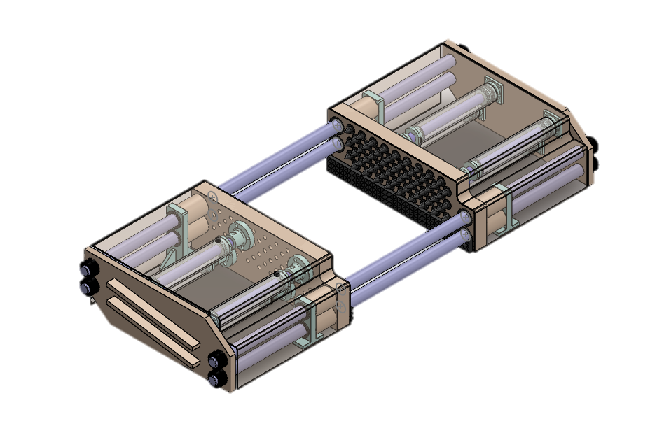
Model created in SolidWorks using new dimensions

